Slide 1


Essential Dermatology
Kirsty Armstrong
ANP in OOH, Expert Witness

Slide 2
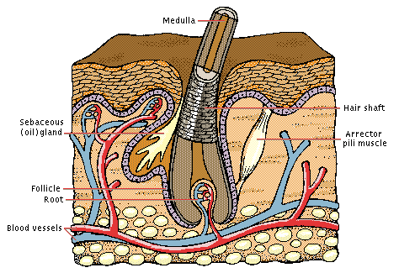
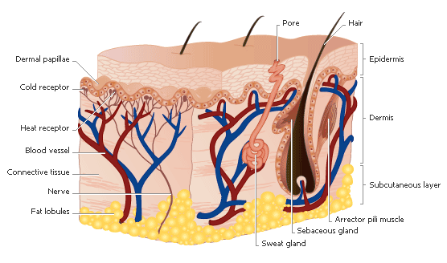
Skin functions
Body Covering
Keep tissue fluids in
Keep chemicals out
Keep bacteria, fungi, and viruses out
Permit movement of underlying muscles & joint
Sensors for touch, pain, and temperature
Adornment
Vitamin D production
Temperature regulation
sweating, blood flow
Sun protection
Detoxification/activation of drugs and chemicals
Immunosurveillance
Langerhans cells, t-lymphocytes
Notes:
A hair grows upward from the root. Lengthening fibers of keratin-filled dead cells, grouped around the semihollow medulla, make up the cortex. A living structure called the bulb (visible as a white lump at the end of a plucked hair) surrounds and feeds the root, which lies in a pocket of the epidermis called the follicle. Hair grows fastest when it is short.
Diseases and Disorders of the Skin
Any component of the skin can become involved in a variety of different diseases. The skin can often provide doctors with clues about the health of the body, since many diseases that affect other organ systems are evident as telltale clues on the skin. For example, a rash, such as that typical of measles or chicken pox, can indicate an infection that affects the whole body. A blue tinge to the skin, called cyanosis, means that the body is not getting enough oxygen and can indicate heart failure. A yellow tinge to the skin, known as jaundice, signals that the liver is not working properly. Other diseases are specific to the skin itself. These disorders range from the merely annoying or distressing, such as acne, to the potentially life-threatening, such as skin cancer.
Acne occurs when a hair follicle becomes blocked, usually by keratin-containing dead cells, preventing sebum from reaching the surface of the skin. Bacteria that normally live in the hair follicle break down the sebum behind the blockage, producing chemicals that cause inflammation in the surrounding skin. The result of this inflammation is a pimple. Acne tends to occur during the teenage years because hormones that increase at puberty promote both keratin formation and sebum production. Acne can be treated with antibiotics that kill the bacteria in hair follicles, with medicines that decrease sebum production, or with chemical applications that remove the hair follicle blockage.
Eczema and Hives
In response to various triggering substances, or allergens, immune cells known as mast cells in the skin may release a chemical called histamine. Other immune cells called T cells may directly damage the epidermis. These events can result in either of two skin disorders, eczema or hives. Eczema is a red, scaly rash that commonly occurs in body folds such as in front of the elbow, behind the knee, and around the groin. It can usually be controlled with oral antihistamines and cortisone creams. Hives, also called urticaria, are red, raised, weltlike lesions on the skin, often occurring on the face and neck. Hives are often triggered by ingestion or inhalation of a substance, such as a medication or food, to which a person is allergic. Therefore, the most effective way of controlling hives is to recognize and avoid future contact with the allergen. Occasionally, hives may be an indication of a more serious, even life-threatening allergic reaction. In such situations, the airways can become constricted, making breathing difficult, and rapid intervention with injections of adrenaline may be required.
Skin Cancer
Any type of cell present in the skin can become cancerous. Two types of cancers of keratinocytes, squamous cell carcinoma and basal cell carcinoma, are together the most commonly diagnosed cancers in the United States and Canada. These cancers can usually be cured by surgical removal. A far more dangerous cancer is melanoma, a cancer that develops from melanocytes. When diagnosed early, it can often be surgically cured, but this form of cancer may spread rapidly, or metastasize, to the internal organs and can be fatal within months of diagnosis. Although less common than cancers of the keratinocytes, the number of cases of melanoma is increasing faster than cases of other types of cancer in the United States and Canada (see Skin Cancer).
All of these types of skin cancer are related to sun exposure. Scientists believe that the sun’s ultraviolet rays damage the DNA of the skin cells, eventually turning them cancerous. Skin cancer develops most commonly on sun-exposed areas, such as the face, hands, arms, and legs. People who have light skin that sunburns easily are at higher risk of skin cancer, as are people who have a history of significant sun exposure, particularly those who regularly sunbathe or those who work outside without protective clothing, such as lifeguards. However, several decades may elapse between sun exposure and the development of skin cancer—someone who was a lifeguard at age 20 may not develop skin cancer until age 50, for example. Moles or other darkly pigmented areas of the skin that change appearance by enlarging, bleeding, or developing irregular borders or coloring may be a sign of cancer. Doctors recommend that people at risk for skin cancer regularly self-examine their body for any skin changes. Whatever their skin tone, people can reduce their risk of developing skin cancer by wearing clothing that covers the body and a hat that shields the face when in the sun and by using a sunscreen with a sun protection factor (SPF) of 15 or greater.

Slide 3
Anatomy Of Skin
Epidermis
Outer layer contains the stratum corneum
The rate limiting step in dermal or percutaneous absorption is diffusion through the epidermis
Dermis
Much thicker than epidermis
True skin & is the main natural protection against trauma
Contains
Sweat glands
Sebaceous glands
Blood vessels
Hair
Nails
Subcutaneous Layer
Contains the fatty tissues which cushion & insulate
Notes:
The epidermis or primarily the outermost layer of cohesive dead cells, known as the stratum corneum, provides the most effective barrier to dermal absorption.

Slide 4
Examination
PRIMARY
Macule→Patch (plaque)
Papule→Nodule
Weal
Vesicle→Bulla
Pustule
Purpura

Slide 5
Secondary Lesions
Scale
Crust
Excoriation
Erosion→Ulcer
Scar
Lichenification

Slide 6
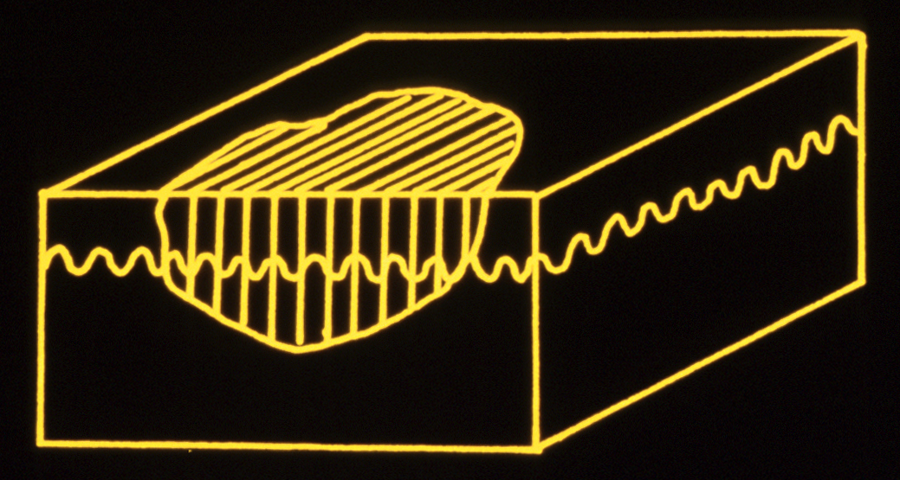
Macule (Macular)
Level with normal skin
Not Palpable
E.g. Freckle (lentigo)

Slide 7
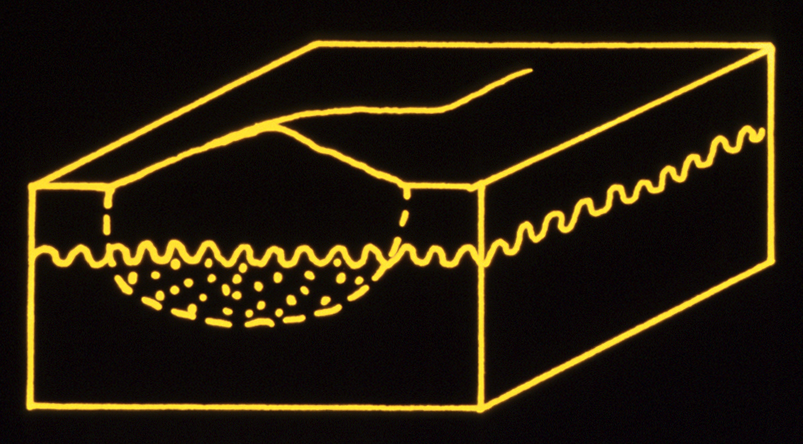
Papule (<5mm) ‘Papular’
Raised above normal skin
Palpable
E.g. pimple / comedone

Slide 8
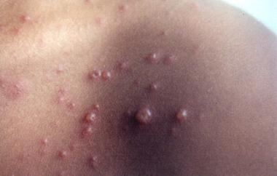
Varicella

Slide 9
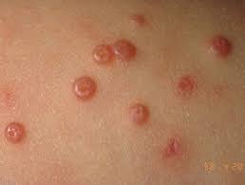
Molluscum contagiosum

Slide 10
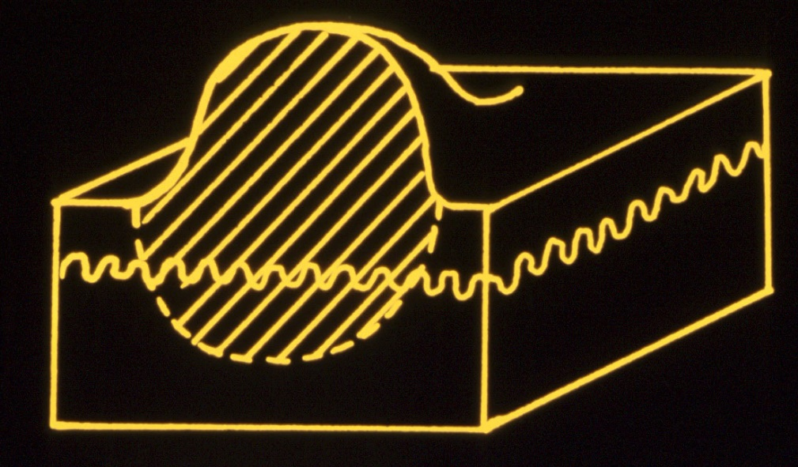
Nodule (≥ 5mm)
Raised above skin level
Palpable (larger than papule ≥5mm)
Can involve any or all layers of the skin
E.g. skin cancer such as Basal Cell Cancer, Squamous Cell Cancer

Slide 11
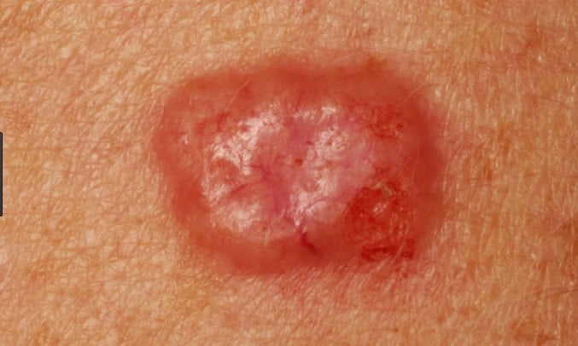
Nodules-BCC

Slide 12
Other derm vocab
Erythematous, Violaceous, golden, flesh coloured, pigmented
Hypopigmented, hyperpigmented, depigmented
Atrophic, hypertrophic, lichenified
Xerotic, excoriated, photodamaged
Annular, Serpiginous, linear
Monomorphic, pleomorphic
Follicular, perifollicular
Acral, truncal, facial, plantar, palmar, flexural, extensor
Discreet, well demarcated, poorly demarcated, coalesce, confluent

Slide 13
Eczema (dermatitis)
Inflammatory condition of the epidermis causing itch and breaking of the skin
Several type of which you are most likely to encounter:
-Atopic
-irritant
-allergic/contact
-dishidrotic (pompholyx)

Slide 14
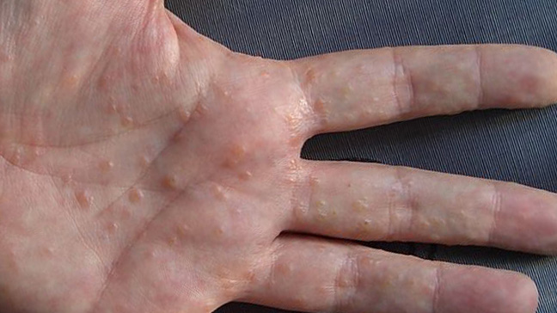
Dishydrotic eczema/pompholyx

Slide 15
Eczema treatment
Total Emollient Therapy
Steroids
Topical immunosuppressant's
Oral antihistamines (break the itch scratch cycle!!!)
Antibiotics/antiseptics (oral abx, salt baths, bleach baths, chlorhexidine soap)
(wet wrapping, occlusion, life style change)
Phototherapy
Immunosuppressant therapies

Slide 16
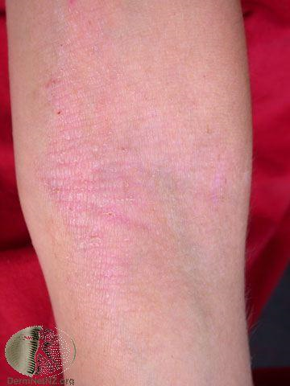
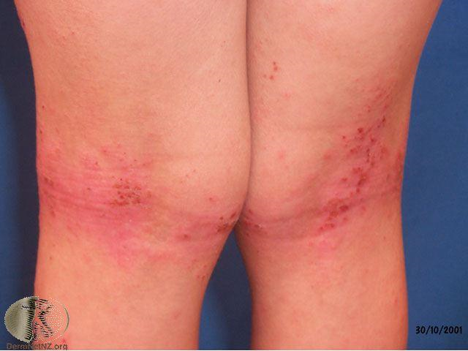

Slide 17
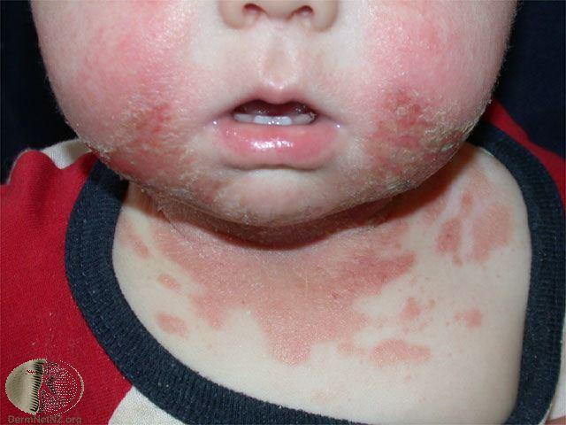
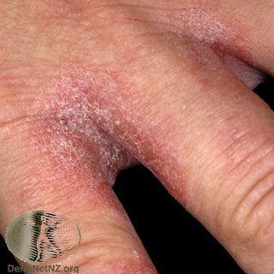
Irritant Contact Dermatitis

Slide 18
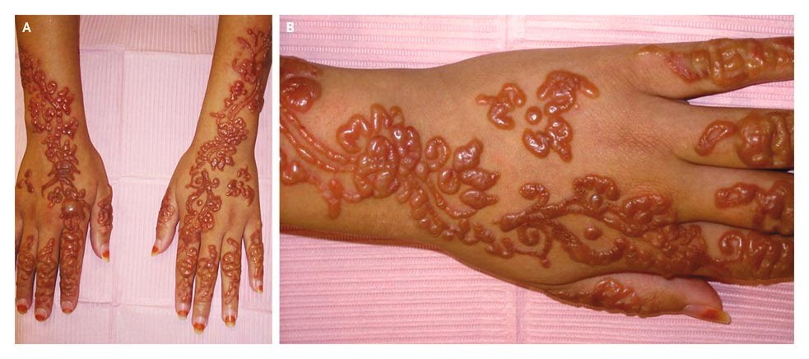
Allergic Contact Dermatitis

Slide 19
Psoriasis
Common chronic inflammatory condition of the skin characterised by red scaly plaques (can affect joints and soft tissues)
Several types of which you are most likely to encounter:
-Chronic plaque psoriasis
-Scalp
-Guttate
-Flexural

Slide 20
Treatment
Emollients
Vitamin d analogues
Steroids
Tar
Salicylic acid
Phototherapy
Immunosuppression and biologics

Slide 21
Ointments
The occlusive effect of ointments can cause folliculitis. If this occurs, occurs, stop the ointment (consider switching to a cream), and prescribe an antibiotic, if necessary.
Aqueous cream is generally not recommended because of the high risk of developing skin reactions.
A clinical audit found that the use of aqueous cream results in a significant proportion of people developing sensitization reactions, so it should be avoided [Cork et al, 2003].
The Medicines and Healthcare products Regulatory Agency (MHRA) warns that aqueous cream may cause local skin reactions, such as stinging, burning, itching, and redness, when it is used as a leave-on emollient, especially in children with atopic eczema [MHRA, 2013]. The reactions, which are not generally serious, often occur within 20 minutes of application but can occur later, and may be due to sodium lauryl sulfate or other additives [MHRA, 2013].
If a topical corticosteroid is prescribed, they should wait several minutes after application of an emollient (about 15–30 mins if possible) before applying the topical corticosteroid [Primary Care Dermatology Society, 2016].

Slide 22
Emollients
Some emollients contain:
Urea (a keratin softener and hydrating agent), for example Aquadrate®, Balneum® Plus, Calmurid®, E45® Itch Relief Cream, and Eucerin® Intensive.
Lauromacrogols (which have local anaesthetic properties, and soothes and relieves itchy skin), for example Balneum® Plus and E45® Itch Relief Cream.
Lanolin or lanolin derivatives, for example hydrous ointment, E45® cream and lotion, and Oilatum® emollient bath additive.
Antiseptic, for example Dermol® preparations (cream, lotion, shower, and bath emollient), Emulsiderm® liquid emulsion, and Oilatum Plus bath additive®.
Emollients containing active ingredients are not generally recommended because they increase the risk of skin reactions. However, they may be useful in some people.
All emollients are available on the NHS, but some are classified as borderline substances and as such their prescriptions should be endorsed with 'ACBS' (Advisory Committee on Borderline Substances). These include Aveeno® products (bath oil, cream, and lotion) and E45® products (emollient bath oil, emollient wash cream, and lotion).
If a topical corticosteroid is prescribed, they should wait several minutes after application of an emollient (about 15–30 mins if possible) before applying the topical corticosteroid [Primary Care Dermatology Society, 2016
[NICE, 2007a; Primary Care Dermatology Society, 2016].

Slide 23
Topical corticosteroids are available in four potencies: mildly potent, moderately potent, potent, and very potent.
These include creams, ointments, lotion, gel, and/or scalp applications, available as non-proprietary and/or proprietary products.
Examples include:
Mildly potent — hydrocortisone 0.1%, 0.5%, 1.0%, and 2.5%
Moderately potent — betamethasone valerate 0.025% (Betnovate-RD®) and clobetasone butyrate 0.05% (Eumovate®)
Potent — betamethasone valerate 0.1% (Betnovate®) and betamethasone dipropionate 0.05% (Diprosone®)
Very potent — clobetasol propionate 0.05% (Dermovate®) and diflucortolone valerate 0.3%(Nerisone Forte®)
All are available on the NHS with an FP10 form. See the British National Formulary (BNF) for a complete list of all the topical corticosteroids available in the UK.
Note that:
Hydrocortisone 1% is available over-the-counter for the treatment of mild-to-moderate eczema not involving the face or genitals.
Very potent topical corticosteroids should usually only be prescribed by specialists. [BNF 72, 2016]

Slide 24
Important Factors not to overlook
Alcohol
Stress
Trauma (including infections ☹)
Medications: NSAIDS, steroids, beta blockers, antimalarials, lithium
Obesity
When examining: ALWAYS THINK TO CHECK:
-scalp
-nails
-Butt crack

Slide 25
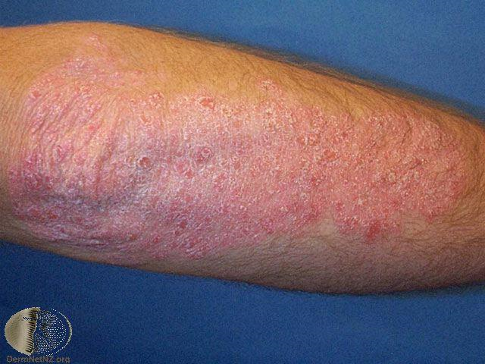
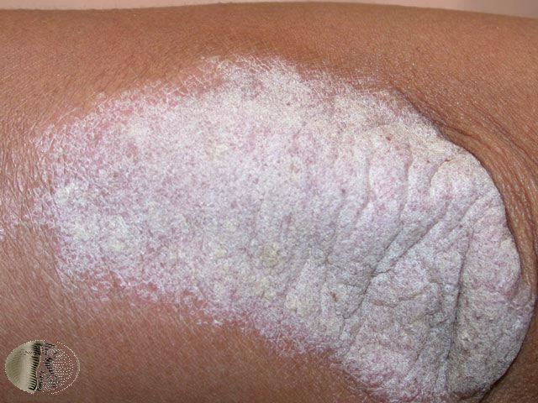

Slide 26
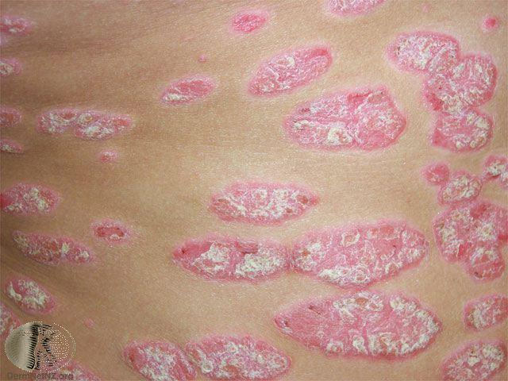
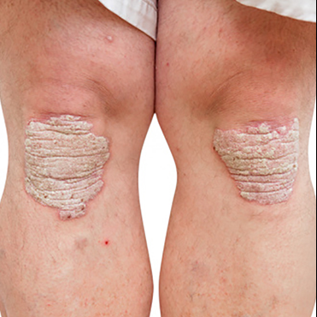

Slide 27
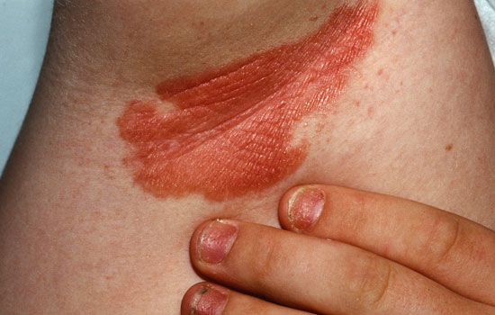
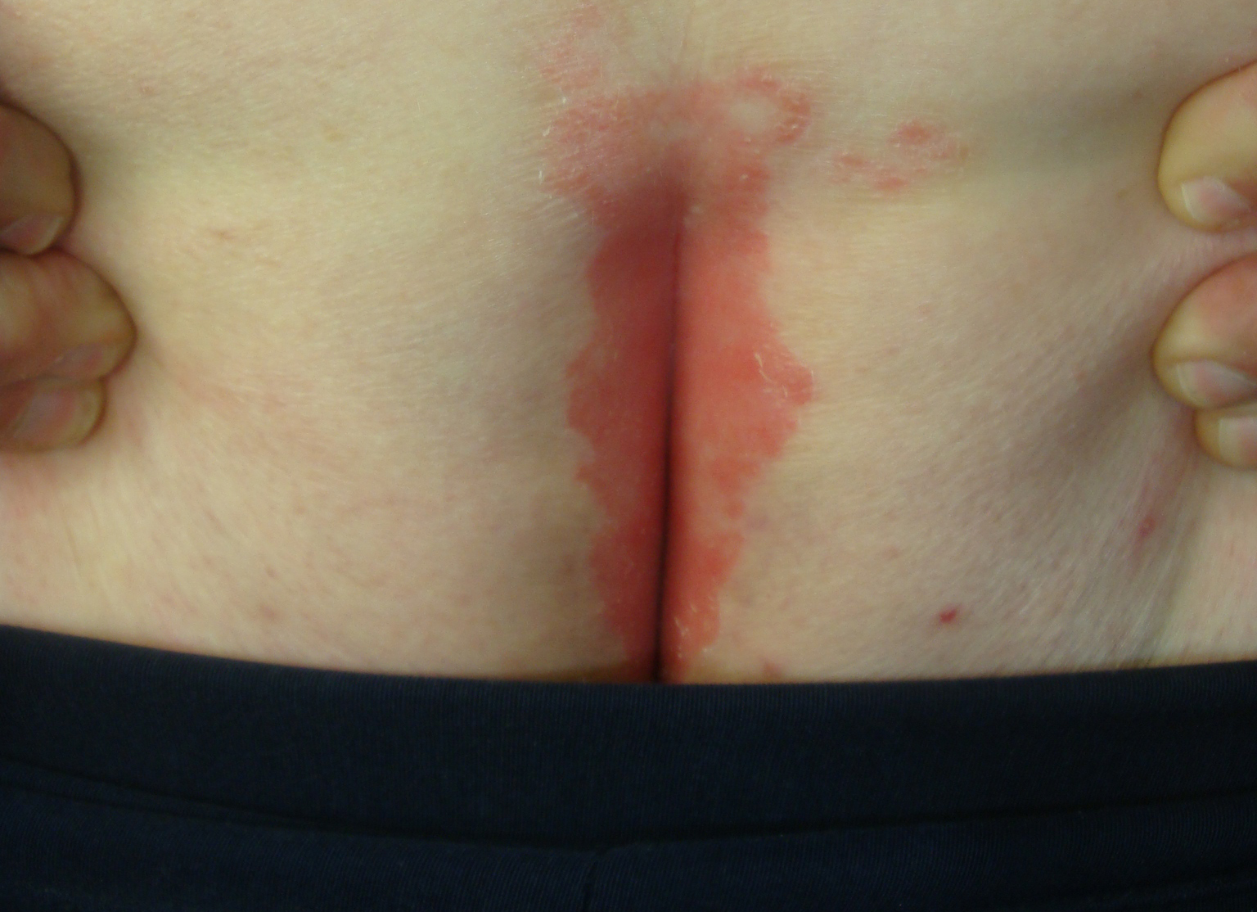

Slide 28
Urticaria
A transient vascular reaction of the skin marked by erythematous smooth plaques (wheals) and usually severe itching. Angiodema can also be present
Many types, of which you are most like to encounter:
-Acute urticaria (virus, insect bites, bacteria, food allergy, drug allergy, drug pseudoallergy, opiates and nsaids)
-Chronic urticaria
-cold urticaria
-pressure urticaria

Slide 29
Treatment
Nothing
Avoiding triggers
Antihistamines (cetirizine, loratadine, fexofenadine)
Oral steroids
Emollient lotions
Biologics
Ciclosporin
Monteleukast

Slide 30
Important things to note
Angioedema
Tongue/throat symptoms
Respiratory involvement
Abdominal involvement
CVS involvement

Slide 31
Scenario
A teenager presents to you with this rash following eating a prawn sandwich for lunch. The school nurse gave him some piriton. What questions should you be asking?

Slide 32
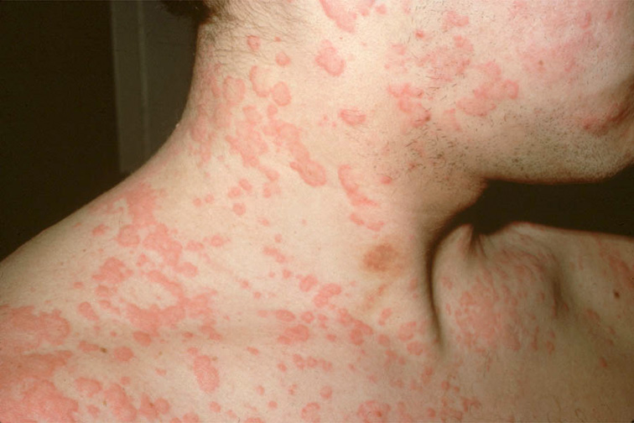
Urticaria

Slide 33
HSV
Type 1: Primary herpetic gingivostomatitis→cold sores
Type 2: Genital
NB: these days the two really overlap!

Slide 34
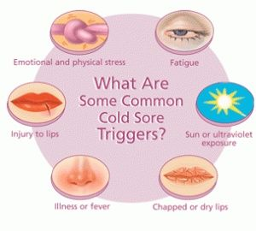
Oral HSV
No treatment
Paracetamol and Ibuprofen
(Topical acyclovir)
(Anaesthetic creams)
(antiseptic mouth washes)
((oral antivirals))
(sun block)

Slide 35
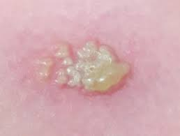
Recurrent HSV1

Slide 36
Self care measures
Self-care measures may be useful for some people. If appropriate, advise the person to:
Clean the affected area with plain or salt water to help prevent secondary infection and promote healing of lesions.
Apply vaseline or a topical anaesthetic (for example lidocaine 5%) to lesions to help with painful micturition, if required.
Increase fluid intake to produce dilute urine (which is less painful to void). Urinate in a bath or with water flowing over the area to reduce stinging.
Avoid wearing tight clothing
Take adequate pain relief.
Avoid sharing towels and flannels with household members on
Advise all people to abstain from sexual intercourse (including non-penetrative and oro-genital sex) until follow-up or until lesions have cleared.

Slide 37
Primary Genital HSV
Oral antivirals are the primary treatment for genital herpes simplex infection — treatment should commence within 5 days of the start of the episode, or while new lesions are forming for people with a first clinical episode of genital herpes simplex virus (HSV).
Prescribe oral aciclovir 400 mg three times a day for 5–10 days, or 200 mg five times a day for 5–10 days, or alternatively:
Valaciclovir 500 mg orally twice a day for 5–10 days.
Famciclovir 250 mg orally three times a day for 5–10 days.
Topical antiviral drugs are not recommended, as they offer minimal clinical benefit.

Slide 38
Recurrent Genital HSV
If self-care measures are not controlling symptoms, management decisions should be made in partnership with the person. Options include:
Episodic antiviral treatment — if attacks are infrequent (less than six attacks per year).
Prescribe oral aciclovir 800 mg three times a day for 2 days, famciclovir 1000 mg twice a day for 1 day, or valaciclovir 500 mg twice a day for 3 days.
Alternatively, for 5-day treatment regimens: prescribe aciclovir 200 mg five times a day (or 400 mg three times a day) valaciclovir 500 mg twice a day, or famciclovir 125-250 mg twice a day.
Consider self-initiated treatment, so antiviral medication can be started early in the next attack.
Suppressive antiviral treatment — if attacks are frequent (six or more attacks per year), causing psychological distress, or affecting the person's social life.
Prescribe aciclovir 400 mg twice a day (or 200 mg four times a day), famciclovir 250 mg twice a day, or valaciclovir 500 mg once a day.
If breakthrough recurrences occur, the dosage should be increased. Consider seeking specialist advice.
Continue treatment for a maximum of one year, after which it should be stopped to assess recurrence (for a minimum of two recurrences). Consider restarting treatment in people who have high rates of recurrence.

Slide 39
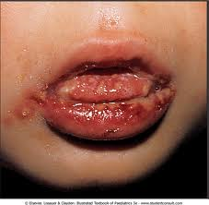
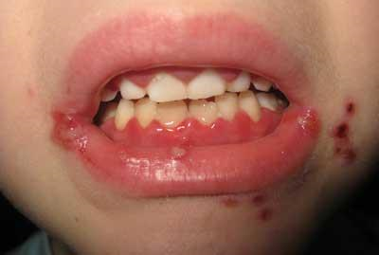

Slide 40
A simple approach to generalised itching
1. Can you see a rash?
No: think systemic disease, psychological disease, menopause, drugs/alcohol, neuropathic or URTICARIA
Yes:
Is there an obvious distribution→ eczema, psoriasis, seb derm
No clear distribution→ xerosis, ichthyosis, scabies, bites
2. Is it urticated?→ urticaria

Slide 41
Fungal Skin infections
Yeasts and fungi can commonly over grow on the skin causing a dermatitis. Usually not serious but often unsightly or itchy.
There are many forms of which you will most likely see:
-Tinea corporis
-Tinea Pedis
-Tinea Mannuum
-Tinea Cruris
-Tinea Capitus
-Tinea Unguum
-Seborrheic dermatitis
-Pityriasis Versicolour

Slide 42
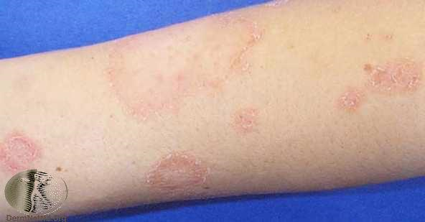
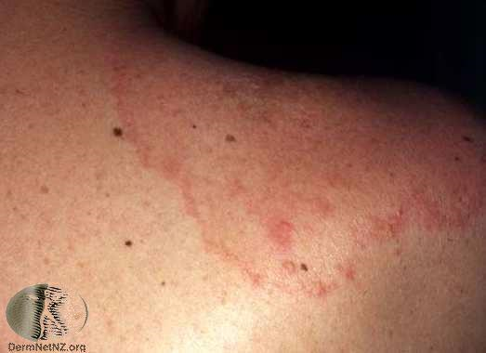
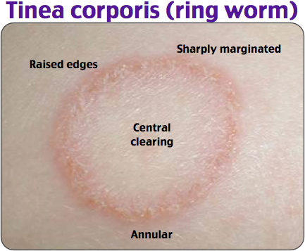

Slide 43
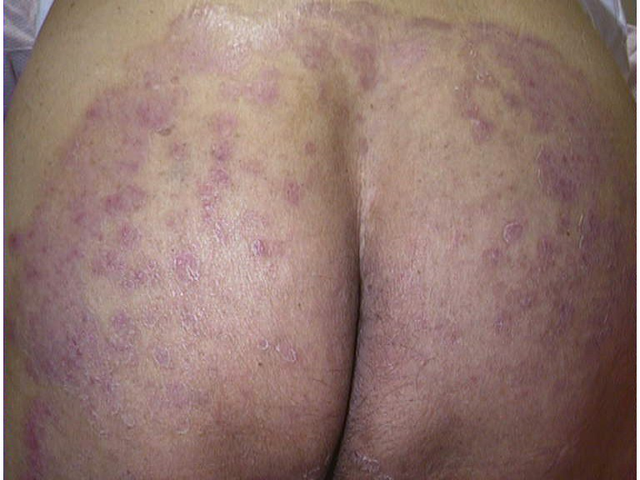
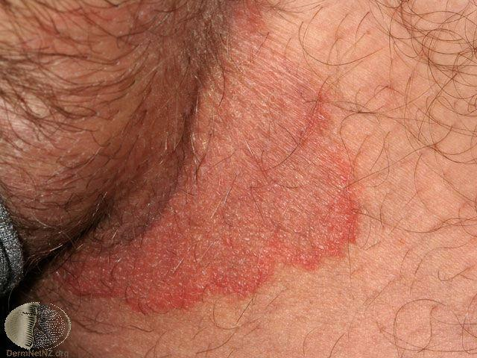

Slide 44
Treatment
If an extensive area is involved, prescribe an antifungal shampoo:
Ketoconazole 2% shampoo — apply once-daily to affected areas for 5 days.
When applying the shampoo, lather, and leave it on for 5 minutes, before thoroughly rinsing off.
Selenium sulphide 2.5% shampoo (commonly used, but this is an off-label indication, and is contraindicated in pregnancy) — apply once-daily to the affected areas for 7 days.
When applying the shampoo, lather, and leave it on for 10 minutes, before thoroughly rinsing off.
It is more likely to cause skin dryness and irritation than ketoconazole shampoo, and some people find the odour unpleasant.
If only small areas are involved, consider prescribing an antifungal cream as an alternative.
Imidazole creams (such as clotrimazole [preferred in pregnancy], econazole, or ketoconazole) can be applied twice a day.
Apply for 2-3 weeks.
Do not prescribe topical or oral corticosteroids.

Slide 45
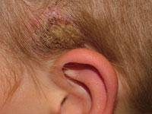
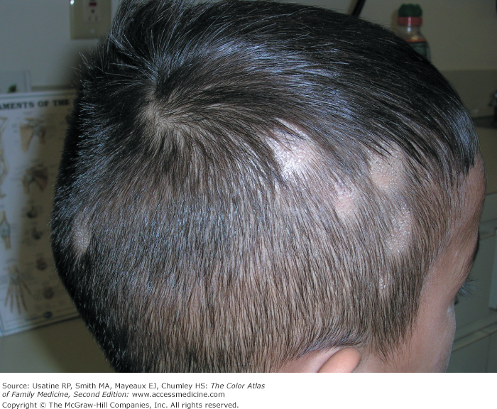
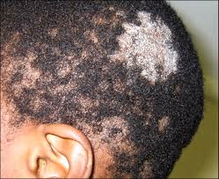
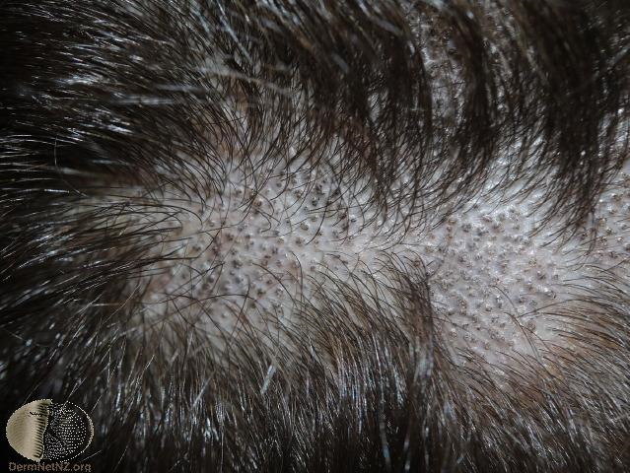

Slide 46
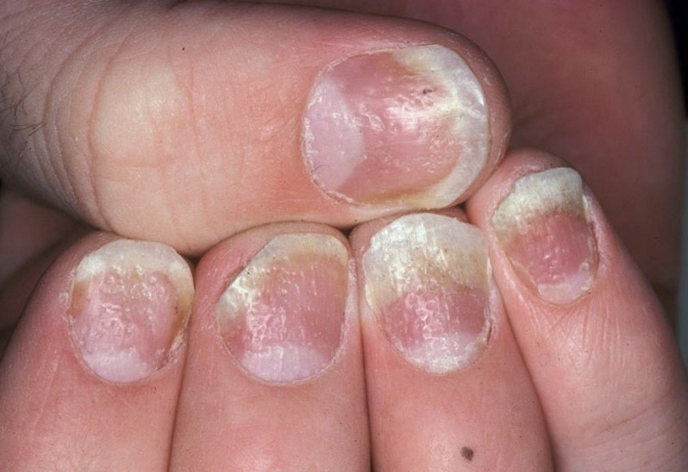
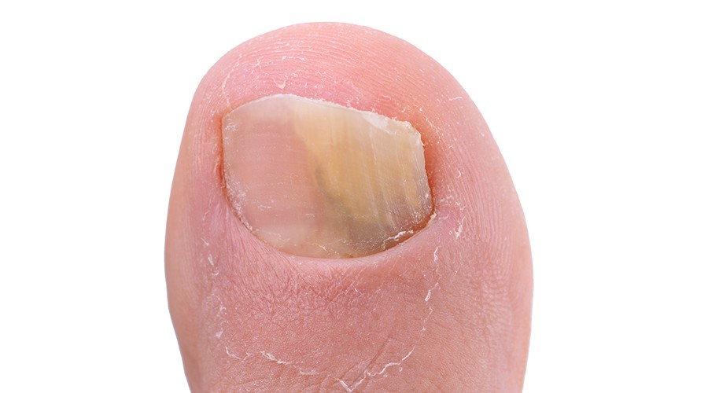
Fungal Nail Vs Psoriatic Nail

Slide 47
Treatments
Topical antifungfals
Topical antifungals with steroid (tinea incognito)
Antifungal shampoos
Oral antifungals
Lifestyle change

Slide 48
Drug Therapy
Dermatophyte only:
Griseolfulvin
Terbinafine
Candida only:
Nystatin
Amphoterocin
Both Dermatophyte and Candida:
Fluconazole
Itraconazole
Ketoconazole

Slide 49
Itraconazole
Dose regime for itraconazole
Various regimes for itraconazole have been found successful; typical doses are listed below. Courses can be repeated and the medication can be continued for months if necessary.
Tinea corporis, tinea cruris: 200 mg daily for one week OR 100mg daily for 2 weeks
Tinea pedis, tinea manuum: 200 mg twice daily for one week OR 100mg daily for 2-4 weeks
Vulvovaginal candidiasis: 200 mg twice daily for one day OR 200 mg daily for 3 days
Oral candidiasis: 100 mg daily for two weeks
Tinea unguium: 200 mg/day for 6-8 weeks (fingernails) or 3-4 months (toenails), OR 200 mg twice daily for 7 days, repeated monthly for 2 months (fingernails) or 3–4 months (toenails)
Pityriasis versicolor: 200 mg/day for 10 days, with a preventative dose of 200mg once monthly for 6 months.

Slide 50
Impetigo
A common infection of the skin with staph aureus causing honey coloured crusting erosions or sometimes bullae.
Also called school sores
Most common in children
Easily treated with oral or topical abx
Almost always minor and quick to respond to treatment
Very rarely can cause severe infection/cellulitis/sepsis/ Staph scalded skin syndrome/rheumatic fever

Slide 51
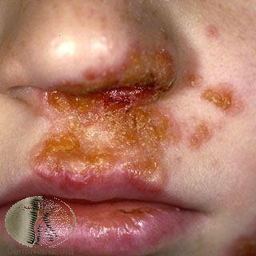
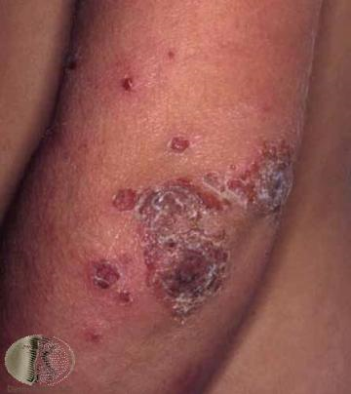
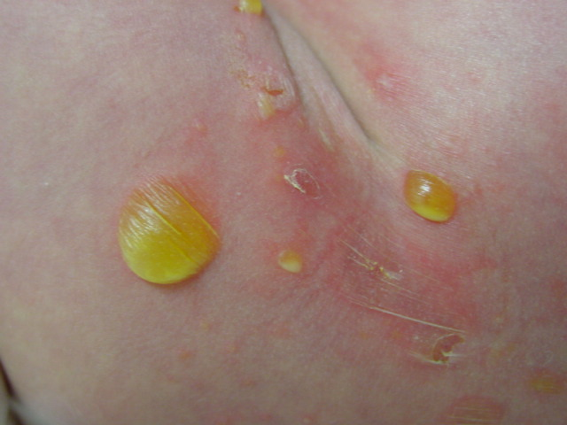

Slide 52
Non-bullous infection requires treatment with topical or oral antibiotics, and management of the underlying cause (if applicable).
For localized infection, treat with topical fusidic acid (three to four times daily, for 7 days).
Before the initial application of topical antibiotics, advise the person (or parent) to remove crusted areas by soaking them in soapy water, as long as this does not cause discomfort.
For extensive infection, areas on which it would be impractical to use topical drugs, or severe infection (including systemic symptoms), treat with an oral antibiotic.
Oral flucloxacillin (four times daily for 7 days) is recommended first-line.
Oral clarithromycin (twice daily for 7 days) or erythromycin (four times daily for 7 days) are alternatives if the person is allergic to penicillins.
The most likely underlying conditions that may be associated with impetigo are atopic eczema, scabies, or head lice. For more information on the management of these conditions, see the CKS topics on Eczema - atopic, Scabies, and Head lice.
Bullous infection usually requires treatment with an oral antibiotic (flucloxacillin or clarithromycin/erythromycin).
Routine follow-up is not required, but advise the person to return if there is no significant improvement 7 days after initiation of treatment (or sooner if the condition is worsening).

Slide 53
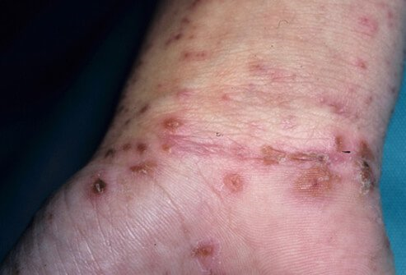
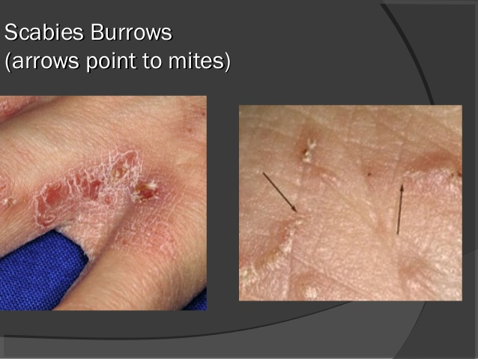
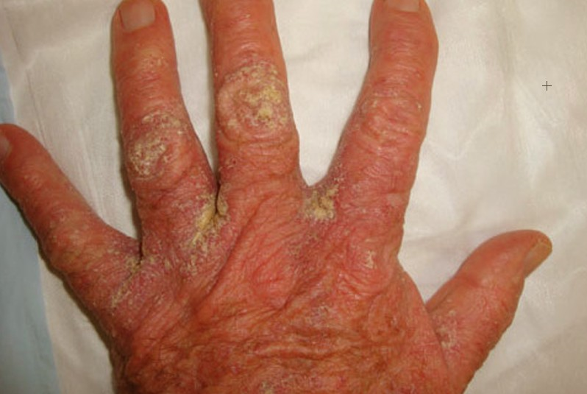

Slide 54
Headlice
A physical insecticide — these silicone or fatty acid ester-based products kill the lice by physically coating their surfaces and suffocating them, so resistance is unlikely to develop.
◾They include dimeticone 4% gel, lotion, or spray (Hedrin® Once or Lotion; Chemists' Own® Head Lice Spray); dimeticone 92% spray (NYDA®); dimeticone > 95% lotion (Linicin® Lotion); isopropyl myristate and cyclomethicone solution (Full Marks Solution®); and isopropyl myristrate and isopropyl alcohol aerosol (Vamousse® Head Lice Treatment), all of which are available on the NHS.
◦ A chemical or traditional insecticide — these poison the lice by chemical means.
◾In the UK, the only chemical insecticide that is currently recommended is Malathion 0.5% aqueous liquid (Derbac-M®), but resistance has been reported.
◦ Wet combing — this is the systematic combing of wet hair with a louse detection comb to remove head lice.
◾The Bug Buster® kit is the only head lice removal (and detection) method that has been evaluated in randomized controlled trials, and it is available on the NHS.
◾Other nit combs listed in the Drug Tariff include Nitty Gritty NitFree comb®, Nitcomb–S1®, and Nitcomb–M2®.

Slide 55
Pubic Lice
◾Screen the individual for Chlamydia and other sexually transmitted infections as appropriate.
◾Treat the individual with a topical insecticide: two applications of malathion 0.5% aqueous lotion or permethrin 5% dermal cream, 7 days apart.
◾Consider follow-up in a GUM clinic in about a week to screen for sexually transmitted infections.
◾Advise the individual to avoid close body contact until they, and their current partner, have been treated.
◾Recommend that the person informs their partners of the previous 3 months that they should be examined for pubic lice and treated if infested.

Slide 56
Scabies:
Treat the person and all contacts with an insecticide.
Use permethrin 5% dermal cream as a first-line treatment.
Use malathion 0.5% aqueous liquid if permethrin is inappropriate (e.g. the person has an allergy to chrysanthemums).
For children under 2 months old, seek specialist advice from a paediatric dermatologist.
Scabies is rare in children under 2 months old.
If malathion is used, an aqueous preparation is preferred to the alcohol-based lotion.
Children under 6 months old require a prescription for an insecticide to treat scabies. If parents prefer to purchase an insecticide over the counter:
Malathion 0.5% aqueous liquid can be purchased for children over 6 months old.
Children under 2 years old require a prescription for permethrin 5% dermal cream.

Slide 57
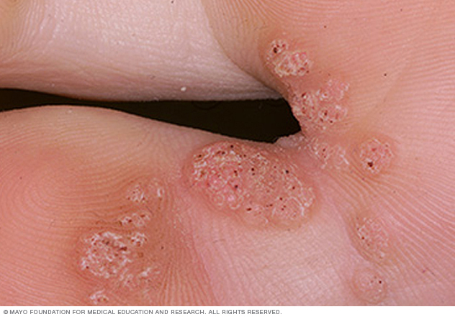
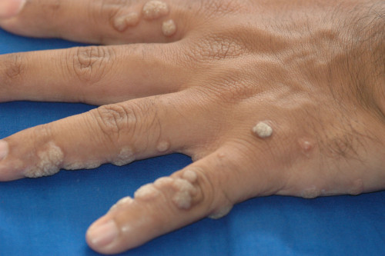
Warts and Veruccas

Slide 58
Acne/rosacea/folliculitis
Acne: think about antibiotic stewardship, think about resistance, think about scarring, think about roaccutane
Rosacea: think about life style change, remember newer agents: ivermectin/brimonidine, metrogel not so good, azelaic acid
Folliculitis: chlorhexidine scrubs, rescue antibiotics, prophylactic antibiotics, does it need drainage? Is it something else?

Slide 59
Things that should make you say ‘Oh dear’
Meningoccocal disease
Urticaria with angioedema/resp involvement/systemic involvement
Eczema herpeticum
Steven Johnson syndrome
Vasculitis
Zoster of the face/ear
Anything genital

Slide 60
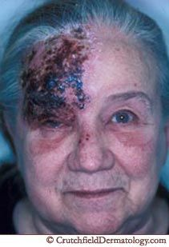
Facial zoster/shingles

Slide 61
When I find things go wrong
Inadequate examination/inadequate exposure
Not looking at meds or drug chart
Not asking about hobbies/job/OTC
Not reviewing diagnosis when not responding
Inadequate safety advice
Not treating for long enough… oral antifungals, topical steroids
Not being realistic about prognosis. Use the word CHRONIC

Slide 62
Life goals
Have eczema, psoriasis and tinea (in their purist forms) really clear in your head
Then start to understand their overlapping and atypical forms
Be totally proficient in common day to day derm infections such as warts, molluscum, impetigo, know the guidelines and rationale and be able to explain them to people
Know about the other treatments available for common skin conditions even if they are outside of your scope of practice, it is great to be able to advise and educate patients
Feel confident about your own traffic light system

Slide 63
Traffic lights for Pharmacists and Nurses (Make your own)
Independent Management: Seb derm Tinea Pedis Plantar and palmar warts (not genital and not elsewhere) Head lice Scabies Nappy rash Dry skin Oral Herpes Acute Urticaria Skin tags | Share Management: Eczema Psoriasis Genital herpes Lichen Planus Chronic urticarial Chronic Ulcers | Refer Management: Eczema herpeticum Non blanching exantham Vasculitis Suspected malignancy Drug eruptions Blistering skin eruptions

Slide 64
Sources of info…
Patient UK
Dermnet
BAD
UKPCDS
CKS
Dermis

Slide 65
Some common mantras
Description is key, then you can get help
Diagnosis is essential, everything else is googleable (and should be googled)
Be safe: competency, honesty, safety netting, referral
Aim to be experts at the simple stuff, this will get you very far
Try to reference what you are doing (NICE, Sign, CKS, local protocol)

